Slide 1
Shell Bootcamp 2024 Reflections for Week 1
NAMAN JAIN
Date : 31-Aug-2024

Slide 2
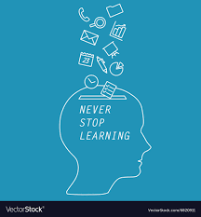
About Me
Never stop learning

Slide 3

My learnings from this week!

Slide 4
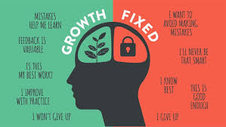
Learning 1 | My takeaways
Growth mindset, right attire and professionalism at workplace
E-mail etiquettes
A growth mindset combined with appropriate attire creates a strong professional impression, fostering confidence, respect, and career advancement.
By adopting these principles, energy professionals can enhance their performance, build strong relationships, and contribute to the industry's sustainability goals.

Slide 5
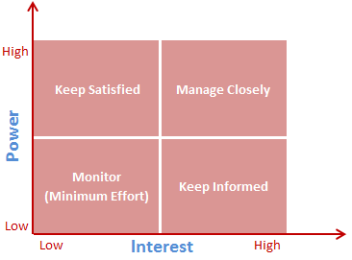
Learning 2 | My takeaways
Stakeholder Management
Power interest grid technique: Inform, Monitor, Collaborate with and manage closely, satisfy
Stakeholder management is vital for the energy sector, particularly for Shell. By effectively engaging with stakeholders, Shell can secure necessary permits, mitigate environmental risks, build strong relationships with communities, and ensure the long-term sustainability of its energy projects.

Slide 6
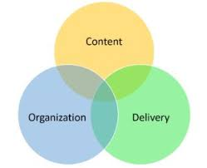
Learning 3 | My takeaways
Elements of an effective presentation
Audience analysis, content, design, delivery
In the energy sector, successful presentations require customizing content for different stakeholders, using clean and professional slide designs, and delivering messages convincingly to foster understanding and gain support for initiatives. This method improves communication and increases the likelihood of project success.

Slide 7
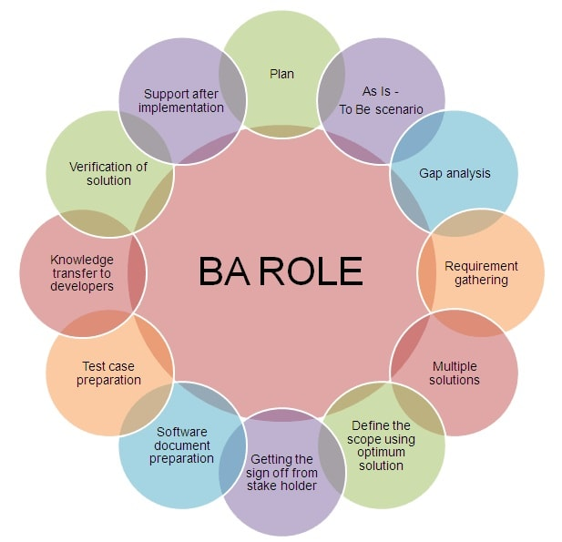
Learning 4 | My takeaways
Business Analyst Roles and Responsibilities
BRD and SRS documentation
Requirement analysis
Software Project Management
Business analysts in the energy sector align business strategies with operational objectives to boost efficiency and sustainability.
BRD and SRS is used to define project goals and requirements for renewable energy, smart grids, and energy management systems.

Slide 8
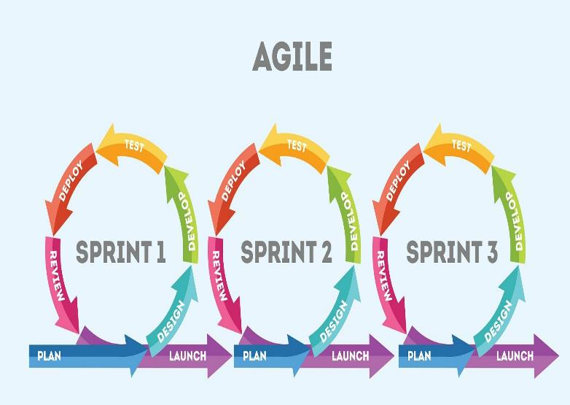
Learning 5 | My takeaways
Software Development Life Cycle
Waterfall model
Vmodel
Prototyping model
AGILE
In the energy sector, SDLC is applied to develop and maintain smart grids, manage renewable energy projects, and build energy management systems. It promotes efficient energy distribution, optimizes usage, and improves reliability with predictive maintenance.

Slide 9

Relevance of learnings for my organization

Slide 10
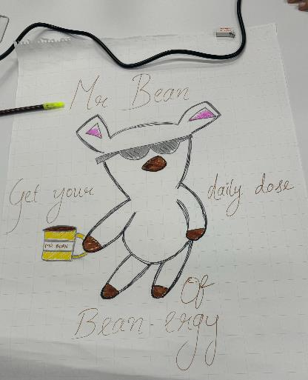

Learning 1 | Relevance for Shell
Shell cultivates a growth mindset by encouraging employees to embrace continuous learning, adaptability, and innovation. Professionalism is upheld through high standards of conduct, integrity, and excellence in all interactions. The emphasis on appropriate attire reinforces a respectful, inclusive, and business-focused environment, reflecting the company's commitment to a positive workplace culture.
Shell gains significant advantages from promoting a growth mindset, professionalism, and appropriate attire by boosting employee productivity, fostering innovation, and upholding a positive corporate image. These practices encourage better teamwork, improve customer relationships, and ensure consistent quality in service delivery, ultimately driving long-term business success in the competitive energy sector.
These were the activity carried out in session for teamwork.

Slide 11
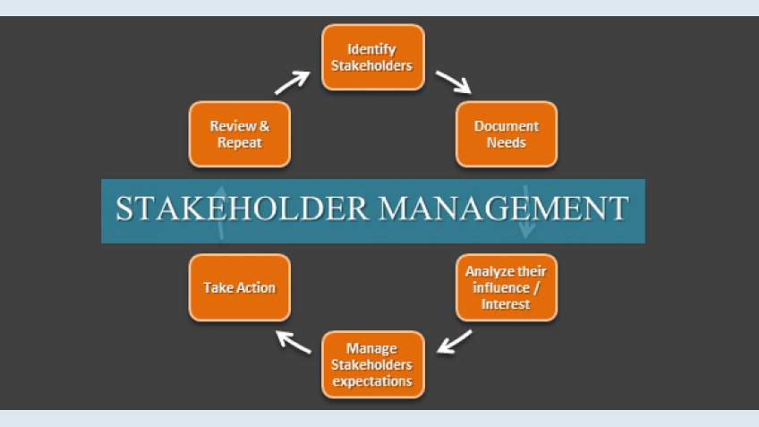
Learning 2 | Relevance for Shell
Shell effectively implements stakeholder management principles by actively engaging with a diverse range of stakeholders, including customers, regulators, and community members. The company prioritizes open communication, transparency, and collaboration, ensuring stakeholder interests are considered. By aligning business strategies with stakeholder needs, Shell fosters mutual trust and long-term partnerships.
By implementing robust stakeholder management principles, Shell builds strong, trusting relationships, enhances its reputation, and gains valuable insights that drive strategic decisions. This proactive approach minimizes risks, improves project outcomes, and ensures sustainable growth, ultimately supporting Shell’s leadership in the global energy industry.
[Add

Slide 12
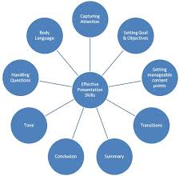
Learning 3 | Relevance for Shell
Shell implements elements of an effective presentation by focusing on clarity, relevance, and engagement. They use well-designed slides, clear messaging, and a structured flow to convey key information. Shell also tailor content to the audience, ensuring that complex ideas are easily understood and actionable.
By implementing effective presentation elements, Shell enhances communication, aligns stakeholders, and supports informed decision-making. This approach helps convey strategic goals, fosters collaboration, and ensures that critical information is retained, ultimately contributing to Shell's operational efficiency and business success.

Slide 13
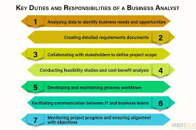
Learning 4 | Relevance for Shell
Shell effectively implements business analyst roles by emphasizing the importance of clear BRD and SRS documentation to define project requirements. Business analysts are involved in software project management, ensuring alignment between business goals and IT solutions. They collaborate with stakeholders to streamline processes and drive successful project outcomes.
By leveraging business analysts, Shell ensures accurate BRD and SRS documentation, leading to well-defined project requirements and better resource allocation. This role enhances software project management, aligning technology with business objectives, reducing risks, and ultimately improving operational efficiency and project success.

Slide 14
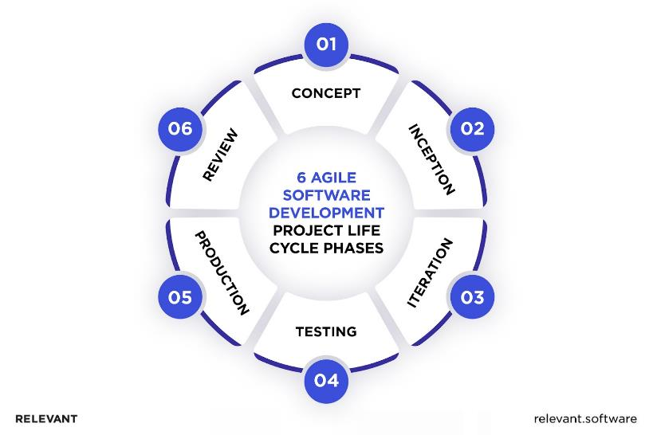
Learning 5 | Relevance for Shell
Shell implements the Software Development Life Cycle (SDLC) by focusing on Agile methodologies. Agile's iterative and flexible approach allows Shell to adapt quickly to changes, enhance collaboration, and continuously improve project outcomes. This method ensures that development aligns with evolving business needs and stakeholder feedback.
By prioritizing Agile within the SDLC, Shell benefits from increased adaptability, faster iterations, and continuous improvement. This leads to more responsive project development, better alignment with business objectives, and efficient delivery of software solutions that meet stakeholder needs effectively.

Slide 15

Challenges in implementing learning

Slide 16
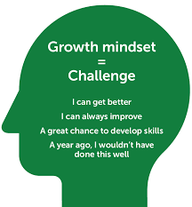
Challenge faced while implementing Learning 1
Challenges: Implementing a growth mindset, appropriate attire, and professionalism can be challenging due to resistance to change, varying personal standards, and inconsistent enforcement.
Overcoming: I will address these issues through clear guidelines, regular training, and positive reinforcement, ensuring everyone understands expectations and their benefits for fostering a productive, respectful workplace.

Slide 17
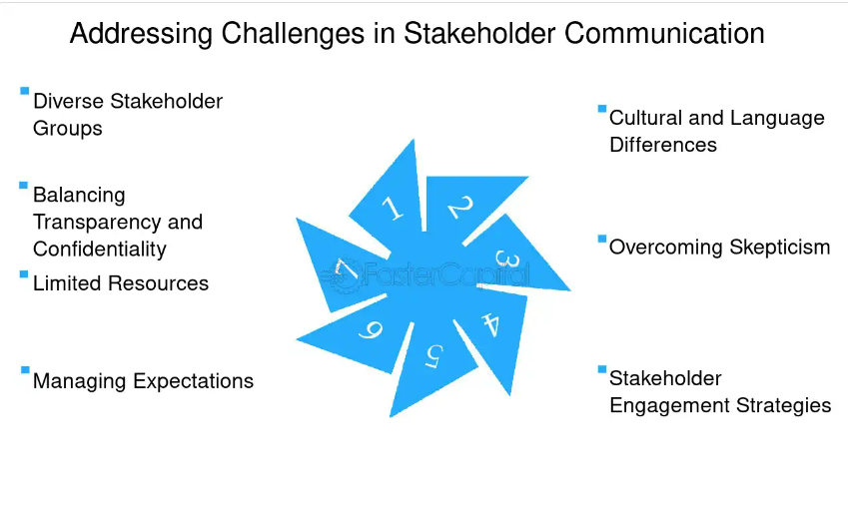
Challenge faced while implementing Learning 2
Challenges: Implementing stakeholder management principles can be challenging due to diverse stakeholder interests, communication barriers, and conflict resolution difficulties.
Overcoming: I will address these challenges by establishing clear communication channels, actively listening to stakeholder concerns, and fostering collaboration through regular updates and transparent decision-making processes to align interests and build trust.

Slide 18
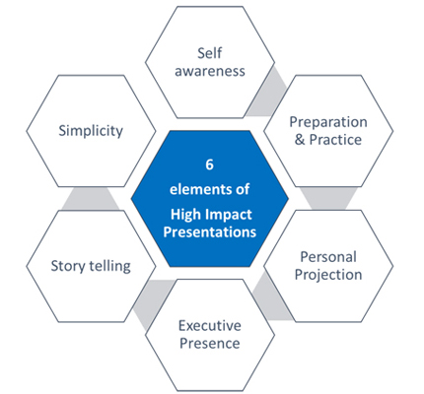
Challenge faced while implementing Learning 3
Challenges: It includes good communication skills, simplifying complex content, engaging a diverse audience, and managing technical issues. These can hinder clarity, audience interest, and overall effectiveness.
Overcoming: I will be distilling content, using clear visuals, and practicing delivery. Test all technical equipment beforehand and incorporate interactive elements to maintain audience engagement and ensure a smooth presentation.

Slide 19
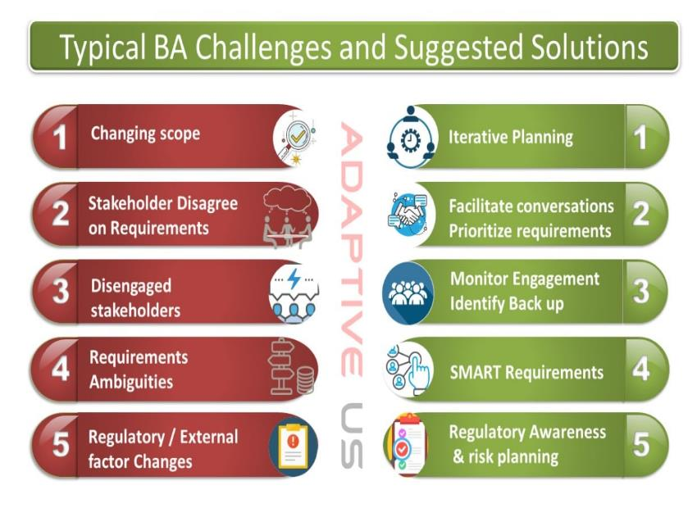
Challenge faced while implementing Learning 4
Challenges: Defining clear requirements, managing stakeholder expectations, and coordinating between technical and non-technical teams. Misalignment and communication issues can hinder effective project outcomes and decision-making.
Overcoming: By establishing clear communication channels, using structured documentation, and regularly engaging with stakeholders. Ensure thorough requirement analysis and foster collaboration between teams to align objectives and improve project outcomes. Proper documentation of business requirement document.

Slide 20
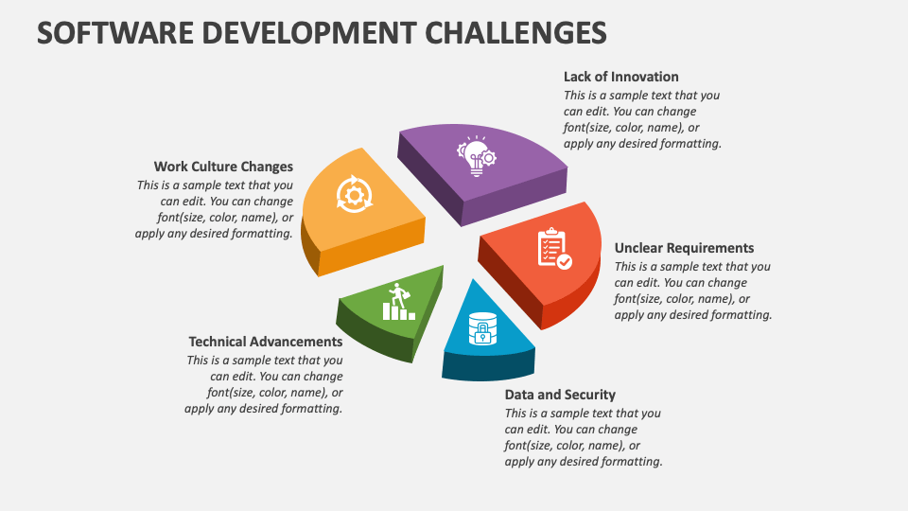
Challenge faced while implementing Learning 5
Challenges: Managing frequent changes in requirements, ensuring consistent team collaboration, and maintaining clear communication. Resistance to Agile principles, misaligned priorities, and balancing iterative development with deadlines can disrupt the workflow and impact overall project success.
Overcoming: By embracing a flexible approach to change, establishing clear communication channels, and prioritizing tasks through regular backlog grooming. Encourage a collaborative team culture, utilize iterative feedback to refine requirements, and set realistic deadlines to balance agility with delivery.

Slide 21

Action Plan

Slide 22
My Action Plan for this Week
Actions
Timeline
Status
Practicing the documentation of BRD and SRS on a specific scenario.
Revisiting and gaining more knowledge on the topics covered.
Working on my communication and presentation skills.
Weekend: Gain more knowledge on SDLC and scrum.
Completed by the end of the week

Slide 23

Learning is also Fun!

Slide 24
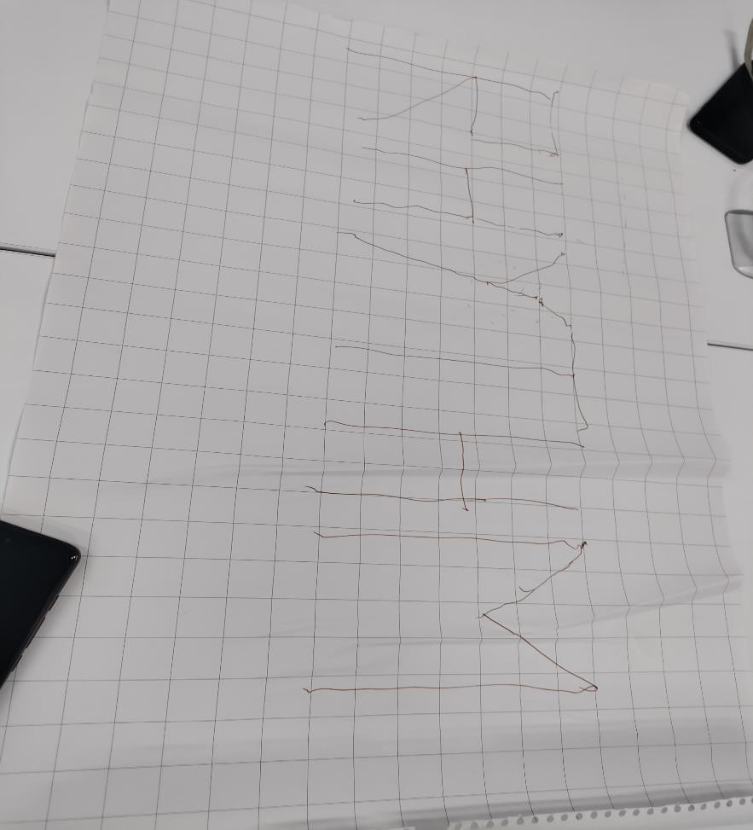
Learning is also Fun!
The soft skill sessions were full of hands on and those activities were fun and educative at the same time. One of the activity which was focused to build team -work quality was drawing a word on a piece of paper by holding the string by all the group members and the knots tied to the pen.
The technical session were full of information along with the real-life stories of the trainer which helps us to understand the concepts not just theoretically but also practically.

Slide 25

Summary
This summary covers key professional concepts like grooming, professionalism, email etiquette, thought leadership, and teamwork. It highlights pacing oneself and being efficient, and understanding different SDLC models including Waterfall, V-Model, Prototype, and Agile. Key learnings include Growth Mindset, Power Interest Grid, effective presentations, Scrum ceremonies, and user story estimation.
The upcoming topics on Agile, DBMS, DevOps, and Software Testing will be valuable for our careers at Shell. Learning about Scrum, Azure DevOps, and testing will enhance my skills as a Software Engineer, enabling me to apply these concepts effectively in my role.
The topics which were taught this week provides the basic blocks for the topics scheduled for next week as the topics like software development life cycle is the base on which a project works.

Slide 26
Thank You

